Slide 1
Week 3
Introduction to Java

Slide 2
Ice breaker
Welcome!
Anything fun this weekend?

Slide 3
Topics
Logic
If statements
Expressions

Slide 4

Review
What is the decimal representation of 10111?
What is the base 2 representation of 128/2? (hint: 128 in base 2 is 10000000)
What are the two possible values of a boolean?
When calling a function, is this correct?

Slide 5
logical operators
Helps us make decisions
Helps us consider multiple constraints
Can also have a “short-circuiting” effect
For use with Booleans
Evaluated left to right, use of parenthesis

Slide 6
Logical operators
&& - and
True if both are true
|| - or
True if one is true
! – not
Flips the Boolean
== - comparing

Slide 7
Examples
true && true -> true
(true && false) && true -> false
true || false -> true
true|| true -> true
!true -> false
5 == 6 -> false

Slide 8

Other operators
Relational operators
>
<
>=
<=
When comparing String types, use .equals()
== and these other relational operators will not work properly

Slide 9
Exercises
1. (true || false) || (false && false)
2. (192 == 384/2) || false
3. !(true && (true || 5 > 6))

Slide 10
But how do we apply this to code?

Slide 11
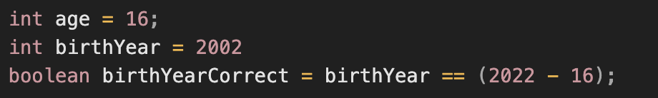
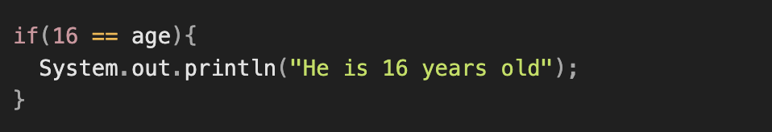
If statements and booleans
Assigning variables
If statements

Slide 12
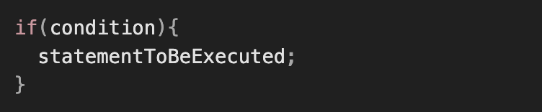
If-statements
Decides whether or not the code inside the if-statement will be executed
Make sure the syntax is correct.
The code inside will only execute if the condition is true.

Slide 13
Exercise
Create a function with an if-statement inside and make it so the function can take in an integer as a parameter. The function should be public static void.
The if-statement will then print a message if the number passed into the function is less than 10.
Call the function from main() multiple times with a range of numbers.

Slide 14
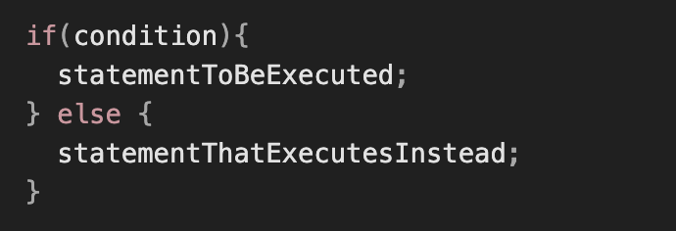
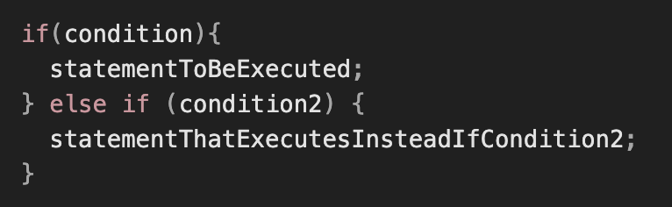
Else, else-if
You can do even more with the use of ”else”, “else if”
Else executes if the original if-statement’s conditional if false.
Else if is the same as else, but only executes if the new conditions is true

Slide 15
Exercise
Add an else-if to your previous function, printing out a message if the number is less than 10 but greater than 5.
Have an else at the end that prints a message.
Note that the else will only execute if the previous if-statement is false along with the else-if. Also note that there may only be one else statement, and only at the very end.

Slide 16
Expressions
We saw some expressions previously
Variables, operators, literals
5 + 6 / 11
(24 % 22 == 2) && true
Expressions always give you something

Slide 17
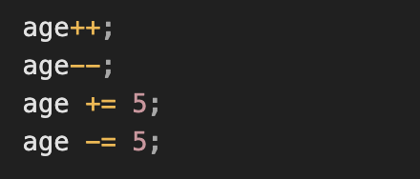
Arithmetic Operators
+ addition
- subtraction
/ division
* multiplication
% modulus
You can also do some cool operators on variables

Slide 18
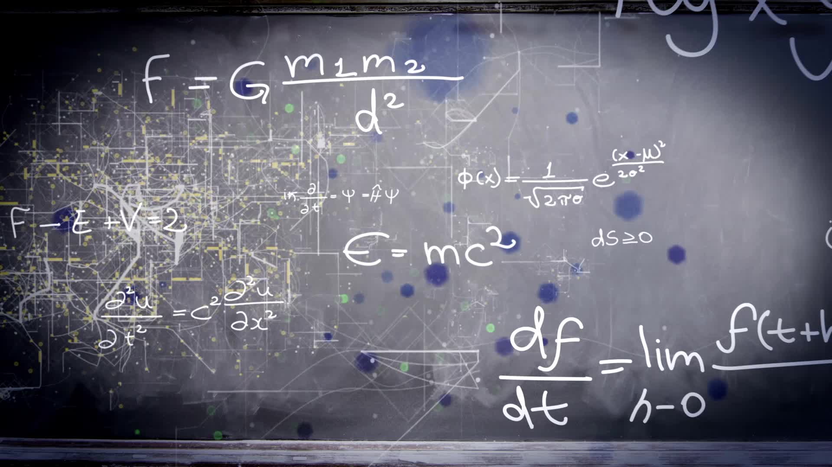
Precedence
Computers do math in the same way we do – with PEMDAS
Parenthesis
Exponent (you won’t see this much)
Multiplication, division, and modulus
Addition and subtraction

Slide 19
Practice problems
5 + 6
25 / 5
234 * 2 + 5
19 % 8 / 3
(32 % 4) * 3 + 1
11 / (67 - 33 * 2)

Slide 20
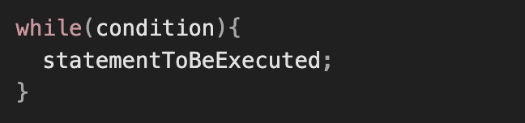
While loops
Loops in java are very helpful – allows for repetition
Be CAREFUL – make sure the condition eventually becomes false

Slide 21
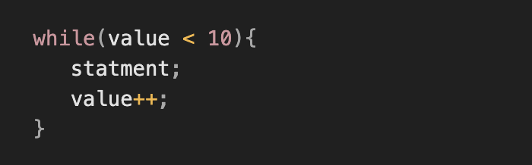
Example

Slide 22
Exercise
Add to the earlier function, except this time use a while loop to print out value + “ is less than 10.” until this is no longer true. Make sure you increment at the very end, and also pass in a starting value.

